Slide 1


SQL for Excel Users

Slide 2
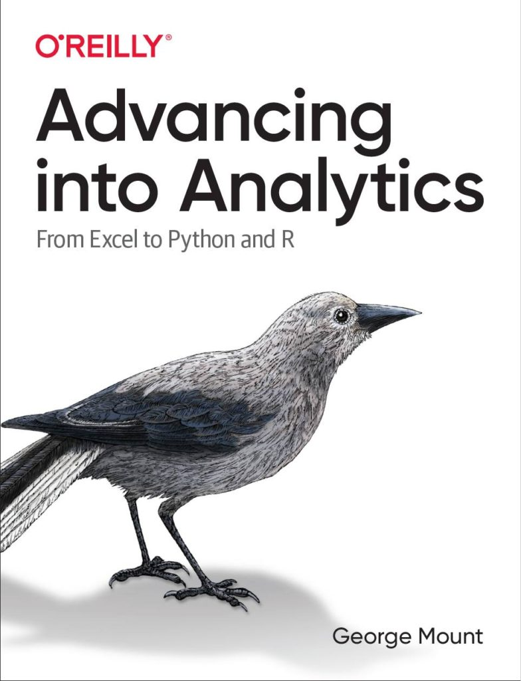


Hi, I’m George

Slide 3

Objectives for this session
Use Pivot Tables to generate summary data, reports, and dashboards in seconds
Create connections across data with the Excel Data Model
Visualize data across multiple tabs

Slide 4
Following along
Each section is a workbook
Solutions in separate workbooks
Follow along with demo notes

Slide 5
1. PivotTables: The WD-40 of Excel

Slide 6

Every PivotTable operation is one of these…
Slice and dice
Drill down/roll up
Pivot/Unpivot
Notes:
Don’t worry too much about the building blocks right now – I have this in here to gauge everyone’s interest

Slide 7
Demo
Using the tips worksheet:
Get the total bill by day, then time
Get the total bill for smokers only on Saturday and Sunday
Get average tips by day for each group size
Notes:
This would be rolling up and drilling down
This is slicing and dicing
This is unpivoting and pivoting

Slide 8
Demo
Using wholesale-customers worksheet:
Get the total sum of sales by Region, then Channel
Notes:
Doesn’t work so well, right?

Slide 9
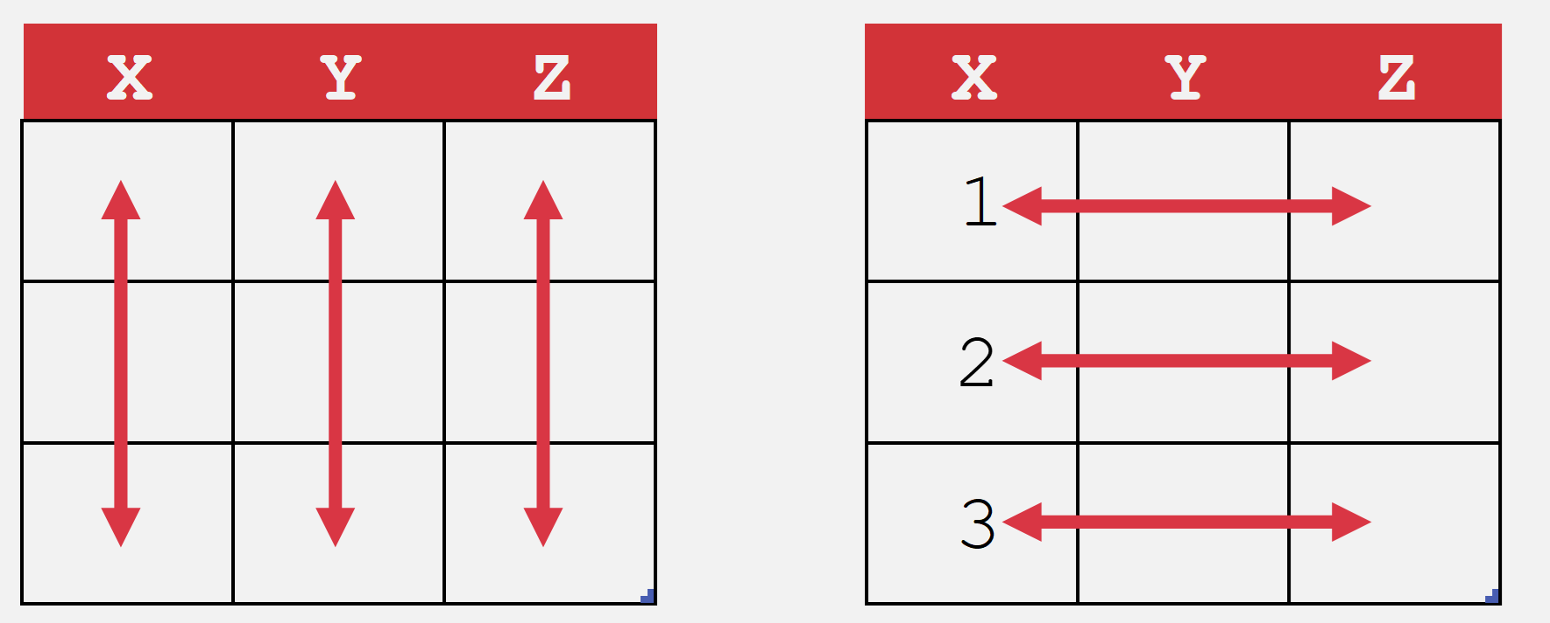
What makes data “Pivot”-ready?
Each variable is in its own column
Each observation is in its own row
Every cell is an observation-variable intersection
Notes:
The Power Query course will be good to actually shape this data. /

Slide 10
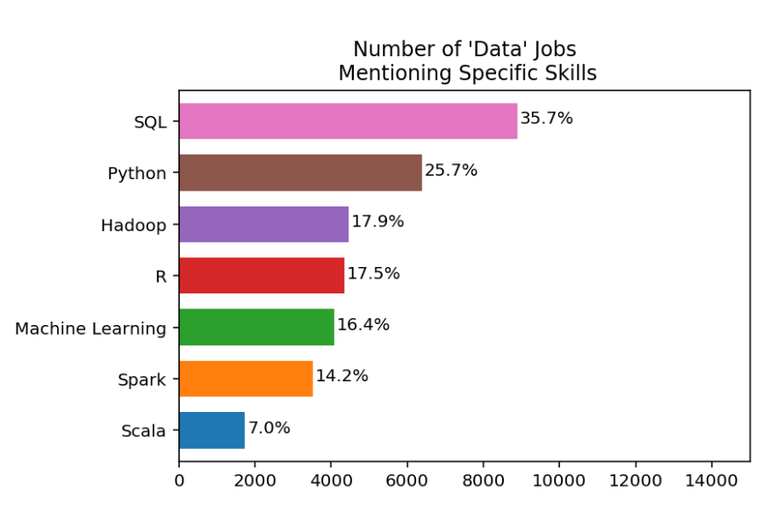
I’m guessing you want work
https://www.dataquest.io/blog/why-sql-is-the-most-important-language-to-learn/

Slide 11

Cross-train your data brain

Slide 12

What is a spreadsheet and when would you use it?
Good for…
Browsing data
Entering/editing data
Flexible data structuring
Quick, visual data analysis on small datasets
Not so much at…
Archiving data
Big data
Interfacing data
Structured data across multiple datasets

Slide 13






Relational databases
1970s origins…
Still with us today!

Slide 14

Meet your librarian
Structured
Query
Language

Slide 15

Are you ready for some baseball?
Lahman database: complete player statistics since 1871 plus salaries, Hall of Fame inductions and more!
Download here for SQLite

Slide 16

Onward to SQLite!
+

Slide 17
ARE YOU READY FOR SOME DRILLS?
How many columns are in Managers?
How many of these columns are of type INTEGER?
How many rows does Managers have?

Slide 18
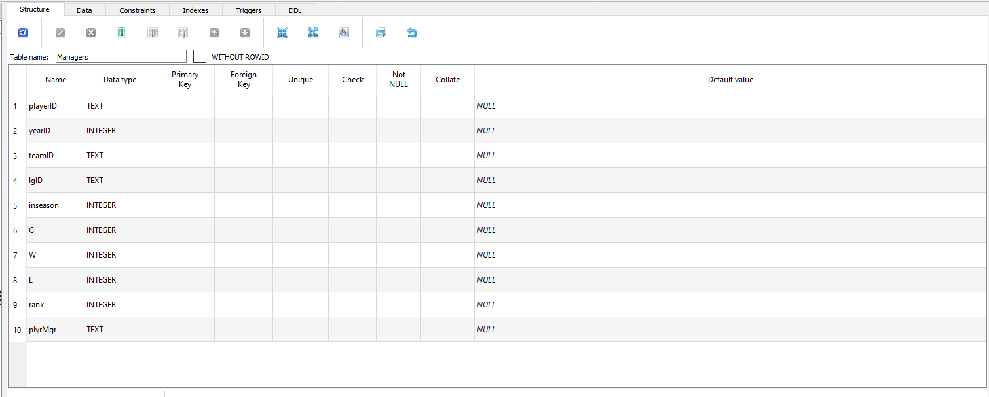
How many columns are in Managers?

Slide 19
2. How many of these columns are of type INTEGER?

Slide 20
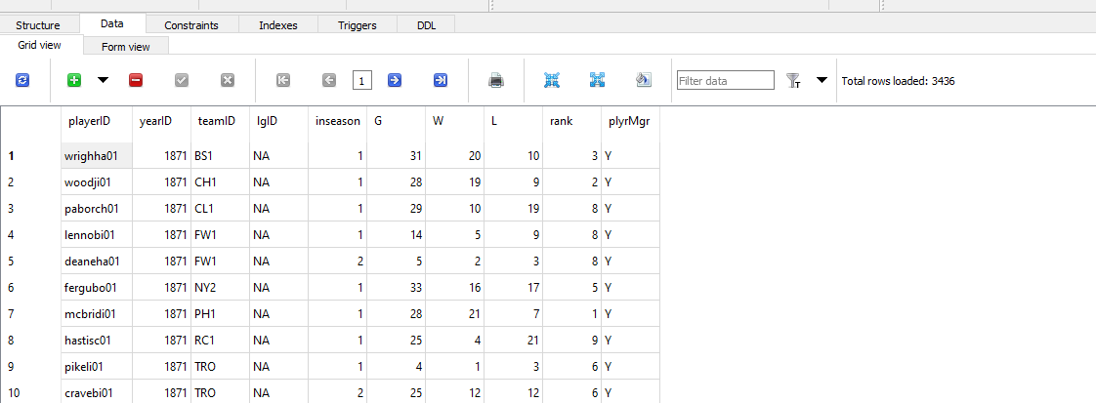
3. How many rows does Managers have?

Slide 21
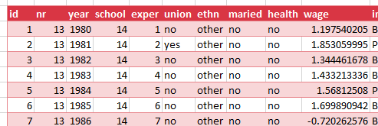
Look to the table
Field/column/attribute
Row/tuple
Value
Table

Slide 22
Questions?

Slide 23
From Excel tables to SQL SELECT

Slide 24
From Excel-ese to SQL-ese
Excel
Data
Calculations
Notes
SQL
Tables
Queries/Scripts
Comments

Slide 25
The grammar of SQL
Term | What it does | Example
Identifier | Identifies an object (i.e. table, field) | Master
Operator | Takes some action (perform calculation,, rename something) | +, AS
Expression | Applies criteria to data | birthYear > 1960

Slide 26

Stylin’ in SQL
0. Good comments starting with –
Each clause on its own line
All operators uppercase (SELECT, ORDER BY, etc.)
Statements end with semicolon (;)

Slide 27
Let’s get coding…
-- List all the tables in our database
SELECT name
FROM sqlite_master
WHERE type='table'
ORDER BY name;
--Get the name and data type from every field in the
--"master" table
PRAGMA table_info(master);

Slide 28
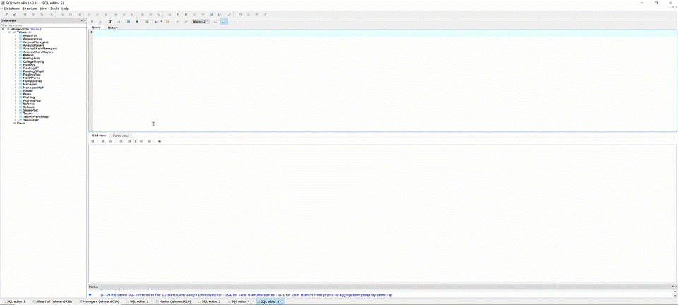
The font is too dang small!

Slide 29
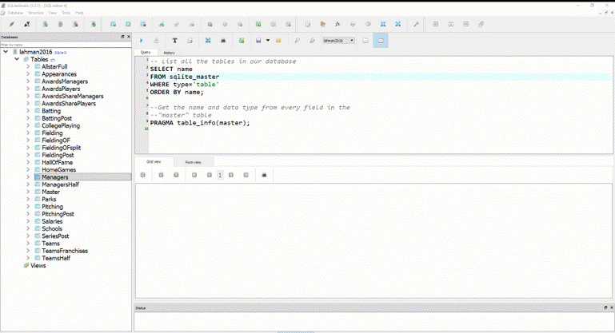
Saving your first .sql script

Slide 30
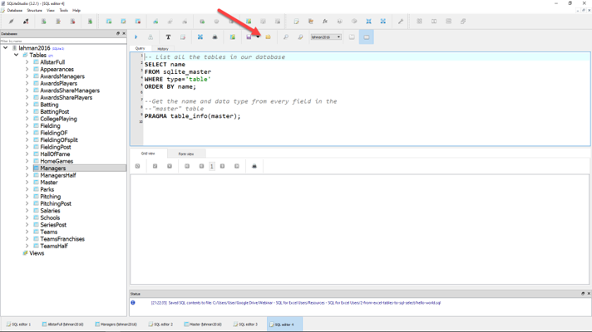
Loading your first .sql script

Slide 31
Demo: sql-tables-example.xlsx

Slide 32
The SQL reader’s digest
Term | What it does
SELECT | Which fields to look for
FROM | Where to look for those fields
WHERE | What criteria those records should meet
GROUP BY | How to aggregate the results
HAVING | What criteria the aggregated results should meet
ORDER BY | How to sort the results
LIMIT | How many records to limit results to

Slide 33
Demo: sql-select-demo.sql

Slide 34
Drills
Using the Teams table:
Select all fields.
Select all fields, first 100 rows.
Select yearID, teamID, W, L.
Select yearID, teamID, and a calculated field win_diff as the difference between W and L.
Create a field team_record such that the first record will read: 1871 Boston Red Stockings: 20-10.

Slide 35
Drills
Using the Teams table:
Select all fields.
Select all fields, first 100 rows.
Select yearID, teamID, W, L.
Select yearID, teamID, and a calculated field win_diff as the difference between W and L.
Create a field team_record such that the first record will read: 1871 Boston Red Stockings: 20-10.
Solutions: sql-select-drills.sql

Slide 36
From Sort & Filter to WHERE and ORDER BY

Slide 37
Demo: sort-filter.xlsx

Slide 38
The SQL reader’s digest
Term | What it does
SELECT | Which fields to look for
FROM | Where to look for those fields
WHERE | What criteria those records should meet
GROUP BY | How to aggregate the results
HAVING | What criteria the aggregated results should meet
ORDER BY | How to sort the results
LIMIT | How many records to limit results to

Slide 39
WHERE: Comparison operators
Operator | Description
= | Equal to
<>, != | Not equal to
> | Greater than
< | Less than
>= | Greater than or equal to
<= | Less than or equal to

Slide 40
WHERE: Logical operators
Operator | Description
BETWEEN | Between an inclusive range
IS NULL | Is a null value
IN | Specifies a range of conditions
OR | Avoids evaluating second condition if first is met
AND | Can be used with other operators
NOT | Excludes results

Slide 41
WHERE LIKE: Wildcard operators
Operator | Description
‘a%’, ‘abc%’ | Returns records that start with a, abc
‘_ _ a’,’_ _ c’ | Returns records with a in 2nd position, abc in 3rd position

Slide 42

A note on NULLs
DOES
Indicate a missing value
DOES NOT
Indicate a value of 0
Indicate why it’s missing

Slide 43
Demo: sort-filter-demo.sql

Slide 44
Drills (continues on next slide)
Using the Managers table:
Select all records, sorted newest to oldest, then by playerID alphabetically.
Select all records between the 1991 and 2000 seasons, sorted high to low by number of games, G.
Create a field, win_diff, calculated as W – L. Return the records with the 25 highest values of win_diff.
How many missing values are in the rank field?

Slide 45
Drills (continued from previous slide)
Using the Managers table:
Select all records, sorted newest to oldest, then by playerID alphabetically.
Select all records between the 1991 and 2000 seasons, sorted high to low by number of games, G.
Create a field, win_diff, calculated as W – L. Return the records with the 25 highest values of win_diff.
How many missing values are in the rank field?

Slide 46
From SUM() and SUMIF() to Aggregation

Slide 47
Demo: aggregation-demo.xlsx

Slide 48
Basic arithmetic functions
Operator | Description
SUM() | Total of records
AVG() | Average of records
MIN() | Minimum value of records
MAX() | Maximum value of records
COUNT() | Count of non-null records

Slide 49
Basic string functions
Operator | Description
CONCAT() | Concatenates fields together
LEFT() | Returns left X values from a string
RIGHT() | Returns right X values from a string
UPPER() | Returns capitalized string
LOWER() | Returns lowercased string

Slide 50
Exploring fields and records
Operator | Description
COUNT(X) | Counts all non-null records of X
DISTINCT X | Returns all distinct values of X
COUNT(DISTINCT X) | Counts distinct values of X

Slide 51
Demo: aggregation-demo.sql

Slide 52
Drills (continues on next slide)
Using the Teams table:
Select the maximum and minimum number of runs.
Select the total number of home runs between 2000 and 2010: total_homers.
Count the number of records where the games played is NULL.
Count the number of records with a recorded attendance.
Return a list of all years reflected in the table.
Count the number of unique franchises since 1915.

Slide 53
Drills (continues on next slide)
Using the Teams table:
Select the maximum and minimum number of runs.
Select the total number of home runs between 2000 and 2010: total_homers.
Count the number of records where the games played is NULL.
Count the number of records with a recorded attendance.
Return a list of all years reflected in the table.
Count the number of unique franchises since 1915.
Solutions: aggregation-drills.sql

Slide 54
From PivotTables to GROUP BY

Slide 55
Demo: group-by-demo.xlsx

Slide 56
The SQL reader’s digest
Term | What it does
SELECT | Which fields to look for
FROM | Where to look for those fields
WHERE | What criteria those records should meet
GROUP BY | How to aggregate the results
HAVING | What criteria the aggregated results should meet
ORDER BY | How to sort the results
LIMIT | How many records to limit results to

Slide 57
Demo: group-by-demo.sql

Slide 58
Drills
Using the Teams table:
Return the largest attendance for each team, sorted high to low.
Find the total number of stolen bases, grouped by year and league.
Find the average number of home runs for each season, keeping only years with an average of 150 home runs or more.

Slide 59
Drills
Using the Teams table:
Return the largest attendance for each team, sorted high to low.
Find the total number of stolen bases, grouped by year and league.
Find the average number of home runs for each season, keeping only years with an average of 150 home runs or more.
Solutions: group-by-drills.sql

Slide 60
Capstone: All clauses in one

Slide 61
The SQL reader’s digest
Term | What it does
SELECT | Which fields to look for
FROM | Where to look for those fields
WHERE | What criteria those records should meet
GROUP BY | How to aggregate the results
HAVING | What criteria the aggregated results should meet
ORDER BY | How to sort the results
LIMIT | How many records to limit results to

Slide 62


Try forgetting now…
Term | What it does
SWEATY | SELECT
FEET | FROM
WILL | WHERE
GIVE | GROUP BY
HORRIBLE | HAVING
ODORS | ORDER BY

Slide 63
Try forgetting now…
Term | What it does
SWEATY | SELECT nameFirst, COUNT(nameFirst)
FEET | FROM Master
WILL | WHERE birthCountry != ‘USA’
GIVE | GROUP BY nameFirst
HORRIBLE | HAVING COUNT(nameFirst) > 1
ODORS | ORDER BY COUNT(nameFirst) DESC;

Slide 64
Drills
Using the Teams table:
Find the maximum number of home runs hit by a team for each year since 1980. Include only those years where fewer than 200 home runs were hit by any team. Sort the results from high to low.
For NL teams that won the World Series that year, what was the maximum number of games won? Include only those teams that won at least 100 games for one of those years. Sort the results from high to low.

Slide 65
Drills
Using the Teams table:
Find the maximum number of home runs hit by a team for each year since 1980. Include only those years where fewer than 200 home runs were hit by any team. Sort the results from high to low.
For NL teams that won the World Series that year, what was the maximum number of games won? Include only those teams that won at least 100 games for one of those years. Sort the results from high to low.
Solutions: sql-all-statements-in-one-drill.sql

Slide 66
From VLOOKUP() to JOIN

Slide 67

How do we get information from more than one table at a time?
What makes a relational database, relational?
https://dev.to/helenanders26/sql-series-all-about-sql-joins-15ol

Slide 68
Demo: vlookup-vs-join.xlsx

Slide 69
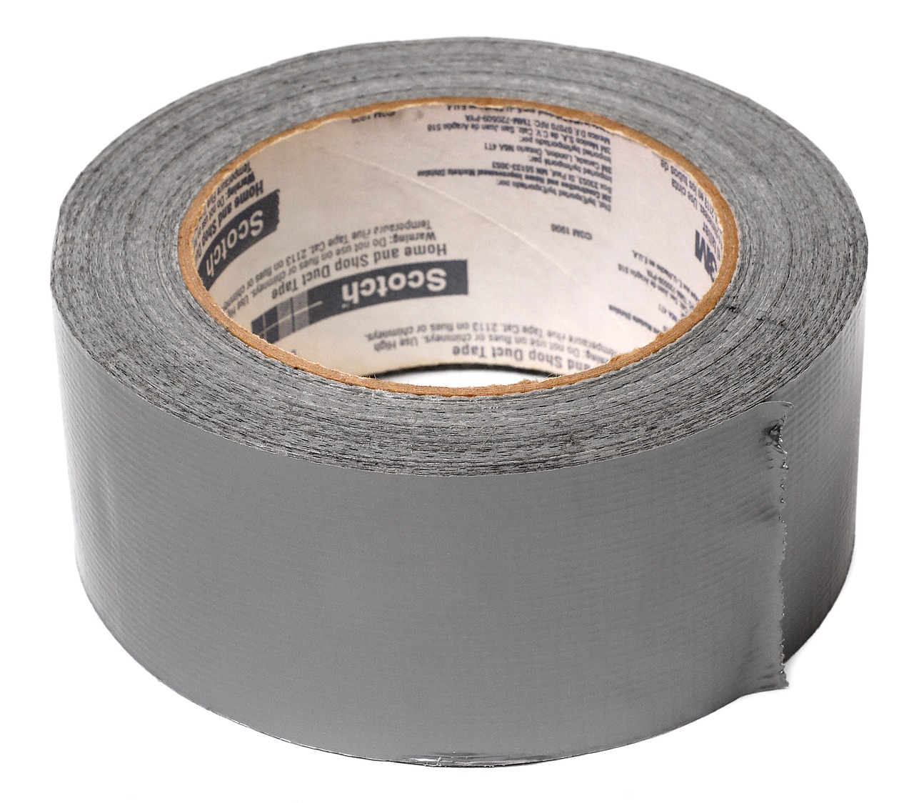

FROM VLOOKUP() Duct Tape to JOIN Blowtorch

Slide 70

Key-lookup
Primary key: Unique, unchanging identifier
Foreign key: References the primary key of another table

Slide 71

Ever been asked for your ID number?
That’s your primary key!

Slide 72
One-to-one relationship

Slide 73
One-to-many relationship

Slide 74
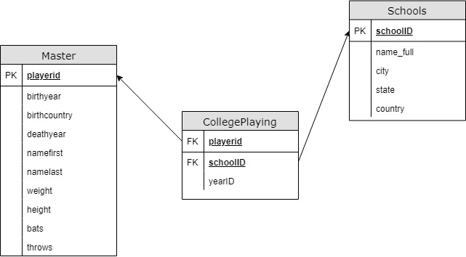
Introducing Schemas

Slide 75
INNER JOIN
Returns records with matching values in both Table A and Table B
TABLE A
TABLE B

Slide 76
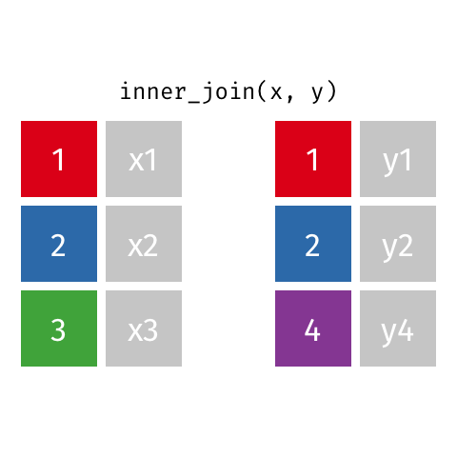
Visualizing an INNER JOIN
https://github.com/gadenbuie/tidyexplain#mutating-joins

Slide 77
Demo: inner-join-demo.sql

Slide 78
Drills
For the Master and HallOfFame tables:
Return a list of unique first and last names for all individuals in HallOfFame
Return first and last names along with the year, votes needed and votes received for all successful HoF inductees
Return the birth year of the oldest individual inducted for each year of HoF inductions. How “old” was each player at induction?

Slide 79
Drills
For the Master and HallOfFame tables:
Return a list of unique first and last names for all individuals in HallOfFame
Return first and last names along with the year, votes needed and votes received for all successful HoF inductees
Return the birth year of the oldest individual inducted for each year of HoF inductions. How “old” was each player at induction?
Solutions: inner-join-drills.sql

Slide 80
LEFT OUTER JOIN
Returns all records from Table A and matching records from Table B. NULL if no match.
TABLE A
TABLE B

Slide 81

Visualizing a LEFT OUTER JOIN
https://github.com/gadenbuie/tidyexplain#mutating-joins

Slide 82
Demo: left-outer-join-demo.sql

Slide 83
Drills
Find the maximum annual salary paid to anyone included in Master, sorted descending by salary.
Keeping the names of all schools listed in Schools, find the first name, last name and years played for all schools (Check CollegePlaying).

Slide 84
Drills
Find the maximum annual salary paid to anyone included in Master, sorted descending by salary.
Keeping the names of all schools listed in Schools, find the first name, last name and years played for all schools (Check CollegePlaying).
Solutions: left-outer-join-drills.sql

Slide 85
From “That’s hard in Excel!” to “That’s easy in SQL!”

Slide 86
Demo: hard-in-excel-easy-in-sql.xlsx

Slide 87
Demo: hard-in-excel-easy-in-sql.sql

Slide 88
CASE expressions
CASE
WHEN condition THEN result-expression
WHEN condition THEN result-expression ...
ELSE result-expression
END AS alias

Slide 89
Subqueries as condition: WHERE
SELECT fields
FROM table
WHERE operator
-- Subquery
(SELECT fields
FROM table);

Slide 90
Common table expressions (CTEs): Expressions acting like tables
WITH
expression_name_1 AS
(CTE query definition 1)
SELECT expression_A, expression_B, ...
FROM expression_name_1

Slide 91
Drills
Using the Teams table:
In 2016, what teams had more wins than the Chicago Cubs (teamID = ‘CHN’?)
Create a field Century which marks records in the 19th Century as 19, 20th as 20 and 21st as 21.
Find the average season minimum attendance since 1990.

Slide 92
Drills
Find the maximum annual salary paid to anyone included in Master, sorted descending by salary.
Keeping the names of all schools listed in Schools, find the first name, last name and years played for all schools (Check CollegePlaying).
Solutions: hard-in-excel-easy-in-sql.sql

Slide 93
SQL: The Prequel

Slide 94

Learning SQL, 2nd Edition
by Alan Beaulieu

Slide 95

SQL Cookbook
By Anthony Molinaro

Slide 96
Find me
georgejmount.com
@gjmount
github.com/summerofgeorge

Slide 97
Thank you

